Slide 1



The Value challenges
Value
The survival and growth of a Community depends on the value it creates for its members or even for nonmembers.
Value is here defined as instant or delayed positive impacts delivered by activities to members or nonmembers

Slide 2
Share your opinions and experiences
Why is your Community currently valuable for your Corporation ?
Good moments for members?
Good moments for members and nonmembers ?
Business Impacts ?
Indirect Business Impacts ?
Other ?
What are the observable and measurable effects of your Community ?
Value
Notes:
Answer :

Slide 3
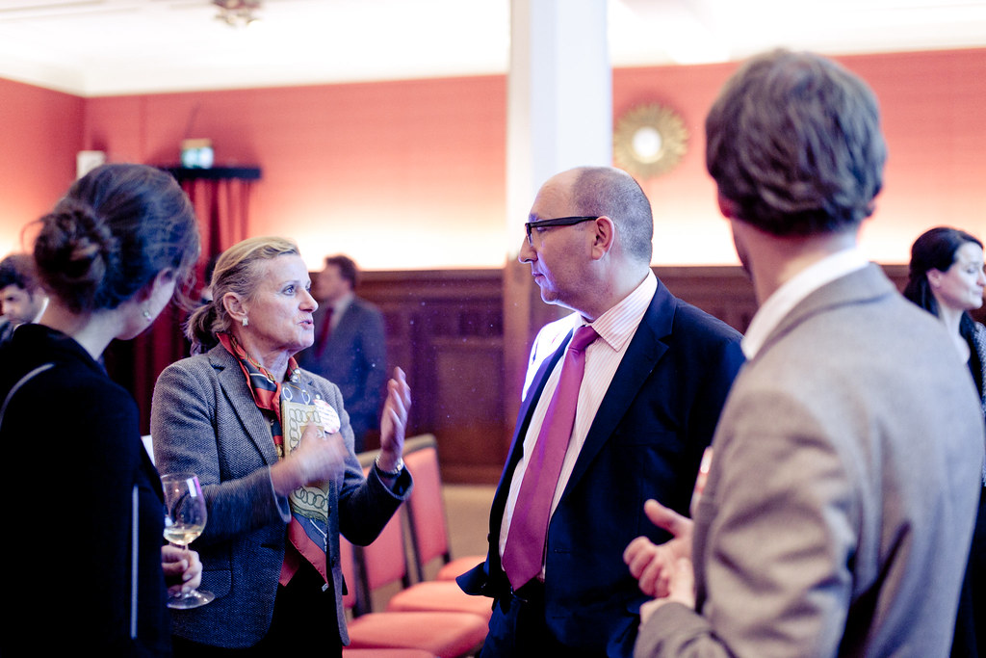

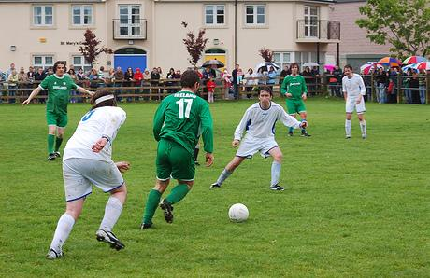

Challenge #V1 Locate the value of your Corporate community
Direct business value
Example : Business opportunity sharing community
Example : Cybersecurity Community
Example : Company’s Football club
Example : Corporate Alumni
Value is mostly for members
Value is for members and nonmembers
Indirect business value

Slide 4
Share your opinions and experiences
With which quadrant are you the most experienced ?
In which quadrants is your Community providing the most value ?
Direct Business value mostly for members
Direct Business value for members and nonmembers
Indirect Business value mostly for members
Indirect Business value for members and nonmembers
Notes:
Answer :

Slide 5

Example story
I have the impression to start all over again, and we have no growth even if we deliver a lot of value
Corporate Community Booster
Notes:
Answer :

Slide 6



Challenge #V2 Exploit Value Momentum
Value Usage
The value produced by a community (positive effects, business benefits, etc.) helps the growth of the Community or its reinforcement
The more value, the higher the chances of growth or reinforcement
Value Momentum
If value is not quickly used for growth or reinforcement, the positive effects forgotten by members and nonmembers. Therefore, momentum will be lost
If value (positive effects) are used for growth, reinforcement, or improvement, momentum is conserved.

Slide 7
Share your opinions and experiences
How familiar are you with managing the momentum ?
How do you usually exploit the positive results of a Community Event ?
Notes:
Answer :

Slide 8

Example story
The Community grew very fast ! That’s a nice news, but now other communities are accusing us of stealing their audience !
Corporate Community Booster
Notes:
Answer :

Slide 9

Challenge #V3 Manage your borders
Compete
The best way wins or dominates
Integrate
Synergy
Differentiate
A & B end up providing different values to different segments
Market specialization
A & B have different ways to provide the value
A & B merge their powers
When 2 communities provide the same value (for a given activity)
Content Curation, Common events, Common structures & processes
Common governance to define
Co-Define the borders and Co-define the segments. Redirect.
Agree on value segments
If your Community keeps on growing, there are high chances that some of its activities resembles activities of another community, leading to competition, integration or differentiation
Community A
Community B

Slide 10
Exercise #V2 Write down how you would exploit the momentum of key value you create
Example
Every time we have a successful event
Send a mail and invite people to join the Community
Ask members to post the picture of them in the event

Slide 11
Share your opinions and experiences
Compete
The best way wins or dominates
Integrate
Synergy
Differentiate
A & B end up providing different values to different segments
Market specialization
A & B have different ways to provide the value
A & B merge their powers
When 2 communities provide the same value (for a given activity)
Content Curation, Common events, Common structures & processes
Common governance to define
Co-Define the borders and Co-define the segments. Redirect.
Agree on value segments
Has your Community ever “competed” with another community ? How did you manage it ?
Have you ever merged or integrated your Community with another ? What did you and why ?
Same questions with differentiation
Notes:
Answer :

Slide 12
Exercise #V3 Identify another Community with which you have borders. Write down your possibilities
Compete
The best way wins or dominates
Integrate
Synergy
Differentiate
A & B end up providing different values to different segments
Market specialization
A & B have different ways to provide the value
A & B merge their powers
Content Curation, Common events, Common structures & processes
Common governance to define
Co-Define the borders and Co-define the segments. Redirect.
Agree on value segments
Our Community
Community B

